Slide 1
LEADERSHIP
THE PERFORMANCE GROUP, INC.
We build your people, so your people can build your business!

Slide 2
Leadership is not
a thing you do…
it is everything you do.
Chuck Stump

Slide 3
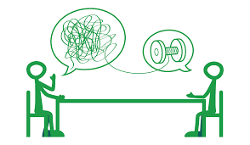
Six “C’s” of Leadership
_______________
________________
________________
_______________
_________________
________________

Slide 4
Symptoms of the “At Risk” Leader

Slide 5
Communication should not be easy to understand…
…it should be IMPOSSIBLE to misunderstand.

Slide 6
“Pace” and “Purpose”
TASK
RESERVED
OUTGOING
(RESPOND)
(INITIATE)
(INTROVERT)
(EXTROVERT)
(PRESENT)
(FUTURE)
(METHODICAL)
(SPONTANEOUS)
PEOPLE
Notes:
SAMPLE ON HOW TO SHARE THIS SLIDE:
In order to understand this assessment, let’s start with this vertical axis. Each end of the axis represents a behaviorial style. Think of this axis as your “orientation to an activity”.

Slide 7
The “Dominant” Leader
_______________________
_______________________
Will be…
Needs…
Limitations…
Tips…

Slide 8
The “Influencing” Leader
_______________________
_______________________
Will be…
Needs…
Limitations…
Tips…

Slide 9
The “Steady” Leader
_______________________
_______________________
Will be…
Needs…
Limitations…
Tips…

Slide 10
The “Conscientious” Leader
_______________________
_______________________
Will be…
Needs…
Limitations…
Tips…

Slide 11
COMPETENCE

Slide 12
“Ability is what you're capable of doing. Motivation determines what you do. Attitude determines how well you do it.
Lou Holtz

Slide 13
The COMPETENCE Test
____________________
Do you have the knowledge, skill and experience?
(Ability)

Slide 14
The COMPETENCE Test
2. ___________________
Do you trust the process that produces the results?
(Attitude)

Slide 15
The COMPETENCE Test
3. ___________________
Does the payoff justify the energy and resources?
(Motivation)

Slide 16
“Give me six hours to chop down a tree and I will spend the first four hours sharpening the axe.”
Abraham Lincoln
Notes:
SAMPLE ON HOW TO SHARE THIS SLIDE:
This picture helps explain one of two concepts that we would like for you to keep in mind. The first concept is called “selective perception”. Selective perception is where we have the ability to hear what we want to hear and to screen out what we don’t want to hear.
For ex. Two individuals listening to a political candidate’s speech. One individual is republican and one individual is democrat. Both hear the same individual deliver a message. Did they hear the same thing? Why or Why not? Conclude that this is Selective Listening. We all do this, but being aware that we do is important.
Ask the group to tell you what they see in the next slide.

Slide 17
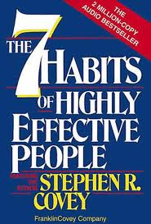
Stay Sharp
Assume you’ve had a heart attack…now live accordingly.
Assume everything you say, others can hear... now speak accordingly
YOU
BODY
HEART
MIND
SPIRIT
Assume you have a 1-1 relationship with your creator…now act accordingly.
Assume the half-life of your career is two (2) years…now prepare accordingly.

Slide 18
CHARACTER

Slide 19
“Ethics is about how we meet the challenge of doing the right thing even when the “cost” involved is more than we want to pay.”
The Josephson Institute of Ethics

Slide 20
The Dilemma
It is easier to do what is ________________.
We do what we need to do to ______.
We __________ choices bases on the situation.

Slide 21
What is CHARACTER ?
_________ = _________
Unfortunately REALITY shows
_________ _________

Slide 22
Why is CHARACTER so critical to a leader?
“________”

Slide 23
TRUST is…

Slide 24
CLARITY

Slide 25
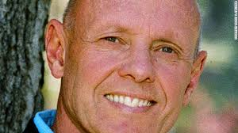
The Execution Gap
__%
__%
__%
__%
could identify the organizations goals and priorities
were truly passionate about the goals
of their time was spent on goals
don’t understand what to do (or WHY it needs done)

Slide 26
As a leader, your job is to _______________, while you ______________________.
How can you do both?

Slide 27
Clarity matters.
Training / Instructions
Roles /Job Descriptions
Evaluation Systems

Slide 28
COMMUNITY

Slide 29
“Teams” are out
____________________
____________________
____________________
____________________

Slide 30
“Community” is in
______________________________
______________________________
______________________________

Slide 31
Community VALUES
C
_______________
A
_______________
R
_______________
E
_______________

Slide 32
Communication
Sender
Receiver
Message
What can a leader do to clear channels and reduce noise?

Slide 33
Speak in a ‘positive’ tense
Tell people ___________________versus what they can’t or shouldn’t do.
Really ___________________. “Re-word” things that come out wrong.

Slide 34
Communication
___________________________
___________________________

Slide 35
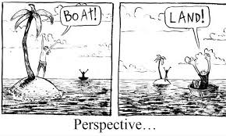
Attitude
(Keep things in perspective.)

Slide 36
Celebrate small victories.
Recognize and reward progress. Don’t wait for perfection.

Slide 37
Attitude
_____________________________
_____________________________

Slide 38
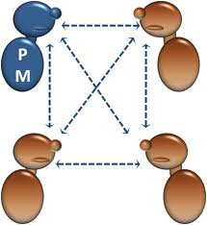
Relationships
n - n
2
=
2
How many “relationships” are there in your community?

Slide 39
Engagement
____________________________
____________________________
____________________________

Slide 40
COACHING

Slide 41
COACHING - 5 Critical Skills
1 - Convey your positive intent
2 - Describe the specific behavior
3 - State the impact of the behavior or action
4 - Ask the other person to respond
5 - Focus the discussion on solutions

Slide 42
1 - Convey your positive intent
“One of our goals here at ABC is to…”
“For our team to function at a high level…”
“It is really important that each member of the team understands…”

Slide 43
2 – Describe the specific behavior
“This morning (afternoon) I noticed…”
“It surprised me to see…”
“I was disappointed to see…”

Slide 44
3 – Explain the impact of the behavior
“I’m concerned …”
“I’m worried that…”
“It isn’t fair to the other members on the team…”

Slide 45
4 – Ask the other person to respond
“Help me understand. What happened?
“How did that happen?
“Share your thoughts with me.”

Slide 46
5 – Focus the discussion on solutions
“Is there anything we can do to…”
“How can we prevent this from happening again?”
“If this continues…”

Slide 47
Coaching - Example
“For us to take care of our customers, everyone needs to be here when they are scheduled to work.¹ Looking at your time sheet, you called off on Monday without notice, and you were late on Tuesday.² That put the team in a really bad spot, but I am even more worried about you. What happened? ³

Slide 48
What we do…
Leadership | Communication | Change Management
Facilitation Services | Business Writing | Coaching
Performance Evaluations | Effective Discipline
Behavioral Styles | Assessments | Customer Service
Negotiation | Meeting Facilitation | Time Management
www.PGroup.US

Slide 49
How did we do?
Once again, thank you for letting The Performance Group, Inc., be a part of your personal and professional development. We would like to know what you thought about the program. Please complete this form and return it to your facilitator before you leave. Thanks again.
YES NO
The facilitator connected with the participants. ⃝ ⃝
What I learned helped me grow professionally. ⃝ ⃝
I feel the training was a good investment of my time. ⃝ ⃝
I would recommend this training to others. ⃝ ⃝
Comments /Suggestions ______________________________________________________________________
_________________________________________________________________________________________________________
I’d like to talk to you about working with my organization.
Name _______________________________________________ Phone ____________________________________

