Slide 1

What is the single most important thing we can do to make West Virginia a great place to be a kid?

Slide 2
What is the single most important thing we can do to make West Virginia a great place to be a kid?
This is the question we think about every day at KIDS COUNT.

Slide 3
Who is KIDS COUNT?
The most trusted source of data about
child well-being.
A builder of alliances to advocate
for what kids need.

Slide 4


Slide 5
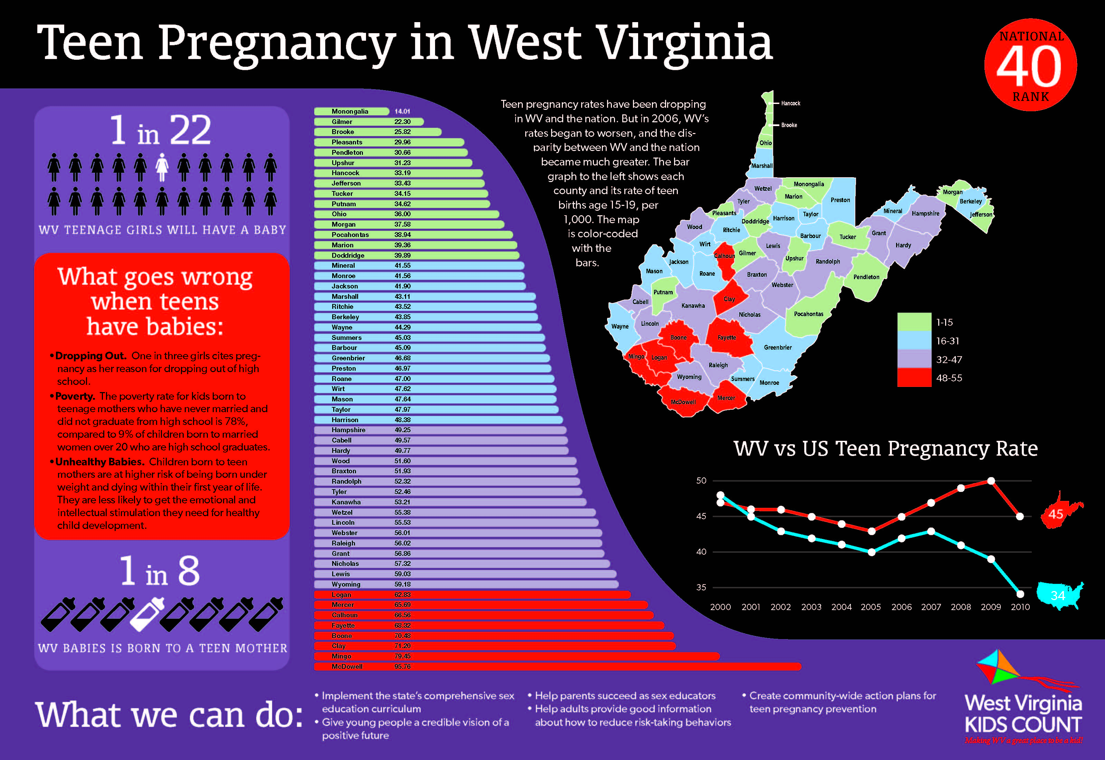

Slide 6
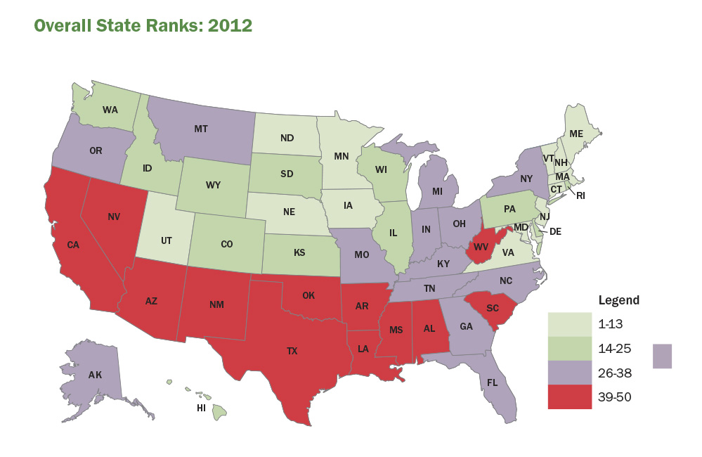

Slide 7
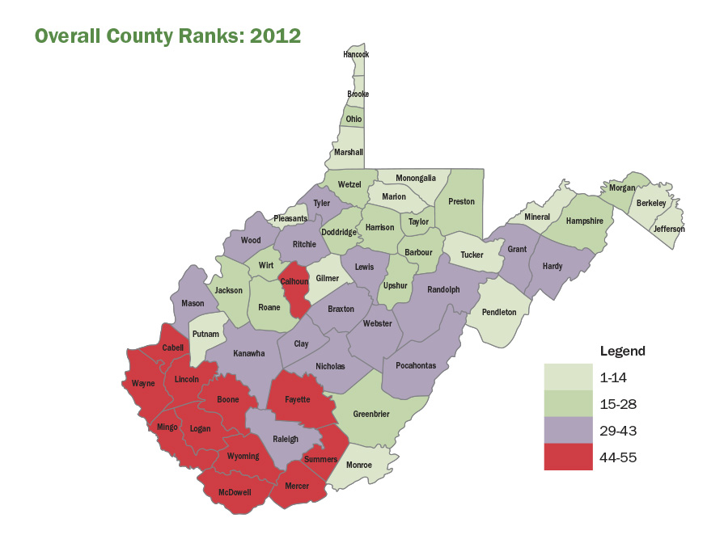

Slide 8
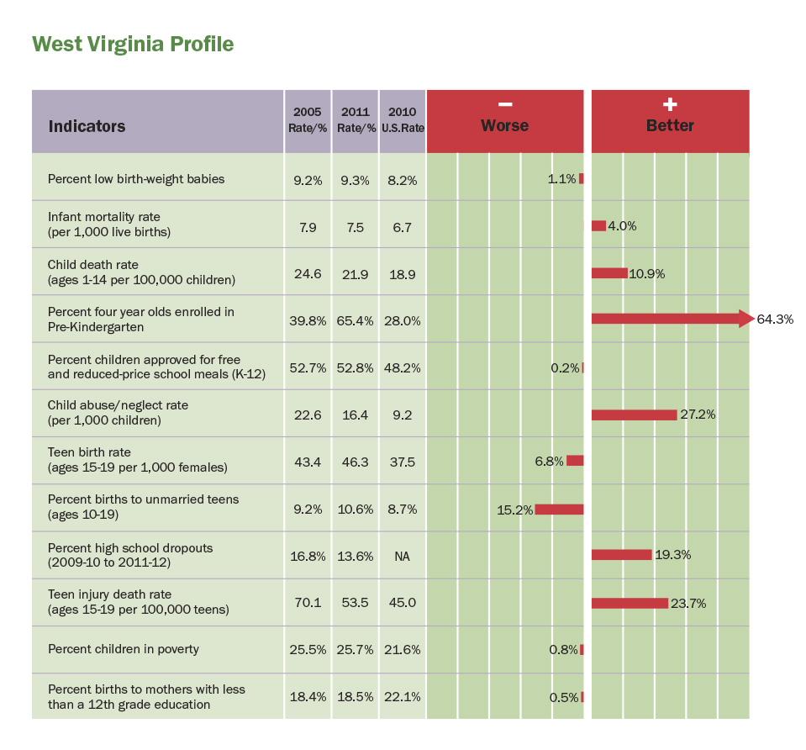

Slide 9
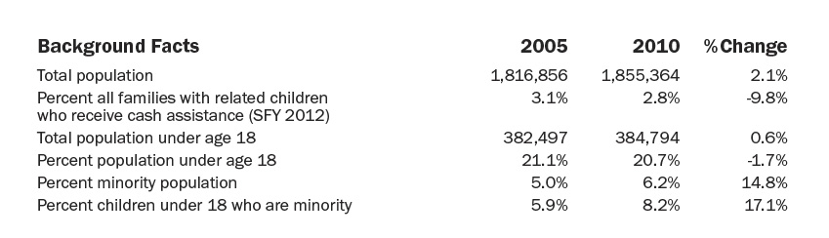
West Virginia Background Facts

Slide 10
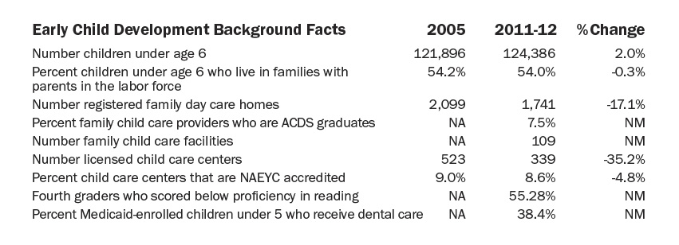
West Virginia Early Child Development Background Facts

Slide 11
West Virginia’s national rank in 4th grade reading proficiency?

Slide 12
West Virginia’s national rank in 4th grade reading proficiency?
43rd worst
Source: Early Warning! Why Reading by the End of Third Grade Matters, A KIDS COUNT Special Report from the Annie E. Casey Foundation, 2010.

Slide 13

How many West Virginia 4th graders can’t read proficiently?

Slide 14
How many West Virginia 4th graders can’t read proficiently?
Source: Early Warning! Why Reading by the End of Third Grade Matters, A KIDS COUNT Special Report from the Annie E. Casey Foundation, 2010.

Slide 15
Why is this one of West Virginia’s most important challenges?

Slide 16
“Up until the end of third grade, most children are learning to read. Beginning in the fourth grade, however, they are reading to learn. It is a make or break benchmark in a child’s educational development.”
Source: Early Warning! Why Reading by the End of Third Grade Matters, A KIDS COUNT Special Report from the Annie E. Casey Foundation, 2010.

Slide 17
How do we lay the foundation for kids to be proficient readers by the end of 3rd grade?

Slide 18

How do we lay the foundation for kids to be proficient readers by the end of 3rd grade?

Slide 19
When is the best time to lay the foundation for kids to be proficient readers by the end of 3rd grade?

Slide 20

When is the best time to lay the foundation for kids to be proficient readers by the end of 3rd grade?

Slide 21
80% of the brain’s development occurs by age 3

Slide 22
64,000 WV kids under age 6 spend most of their day in childcare because their parents are working.

Slide 23
Young children who have high-quality childcare are less likely to :
repeat grades….
get in trouble with the law…
get pregnant too soon…
drop out of high school.

Slide 24
Young children who have high-quality childcare are:
better readers…
more likely to graduate…
more likely to go to college…
get higher paying jobs…
pay more taxes…
live more productive lives.

Slide 25
Most childcare in WV is not high quality.
It is “fair” to “poor.”

Slide 26
The 64,000 kids who need childcare are not getting the early experiences they need to be good readers and, ultimately, productive citizens.

Slide 27
No provider can charge what quality costs, because no parent could afford to pay it. Therefore, most providers can’t offer high quality. Imagine if parents had to pay out of pocket the full cost of public education.

Slide 28
“We will never close the achievement gap, never solve our dropout crisis
and never break the cycle of poverty
if we don’t make sure all children learn to read.”

Slide 29
According to the Marshall University Center for Business and Economic Research, West Virginia will get a $5.20 return on every public dollar we invest in improving the quality of childcare.

Slide 30
What is the single most important thing we can do to make West Virginia a great place to be a kid?

Slide 31
KIDS COUNT’s answer…

Slide 32
KIDS COUNT’s answer… a Childcare Quality Rating and Improvement System.

Slide 33
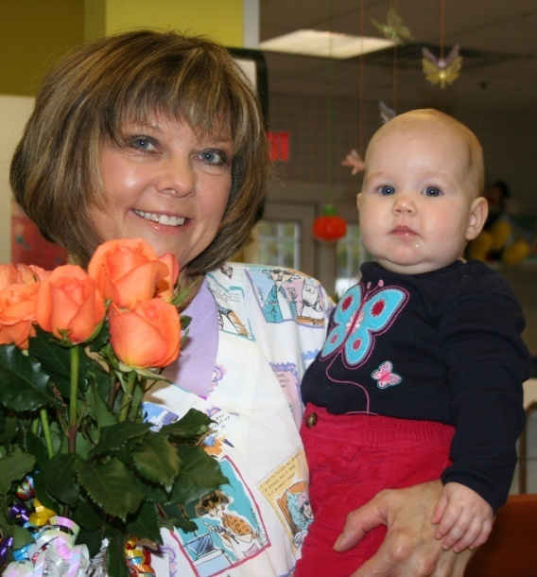

Slide 34
When we invest in a Childcare Quality Rating and Improvement System…

Slide 35
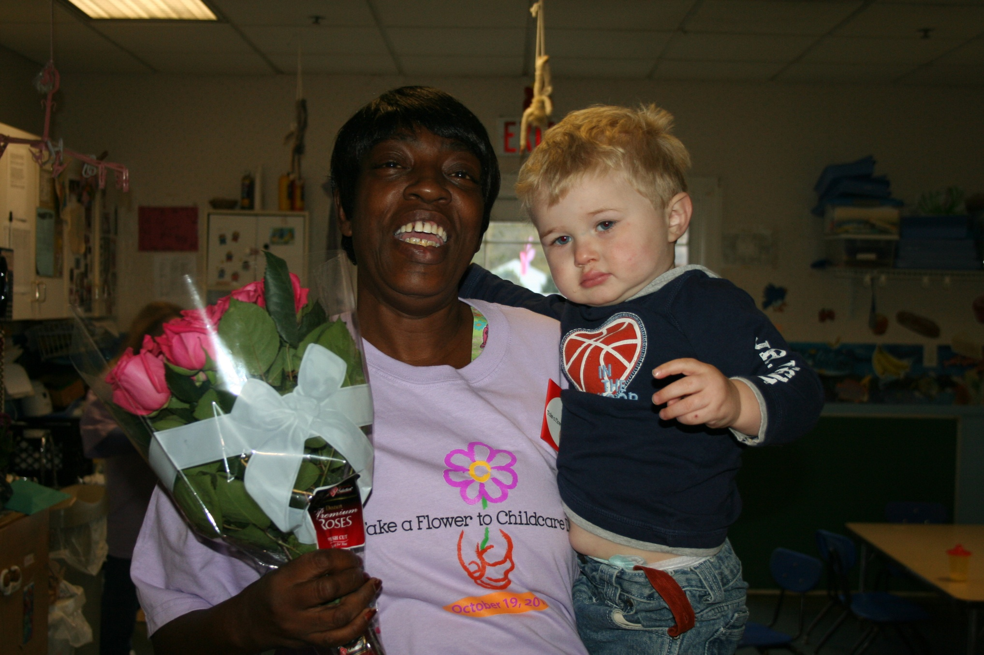
  Children will have a loving environment in which to grow.

Slide 36
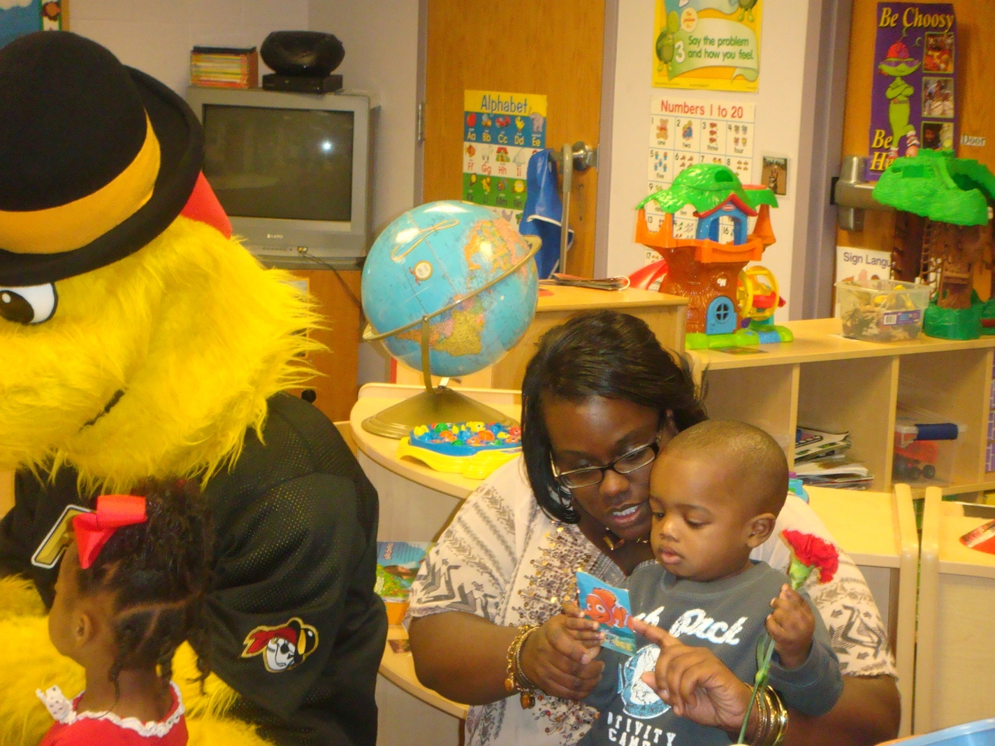
  Good teachers will do lots of talking, reading and rhyming.

Slide 37
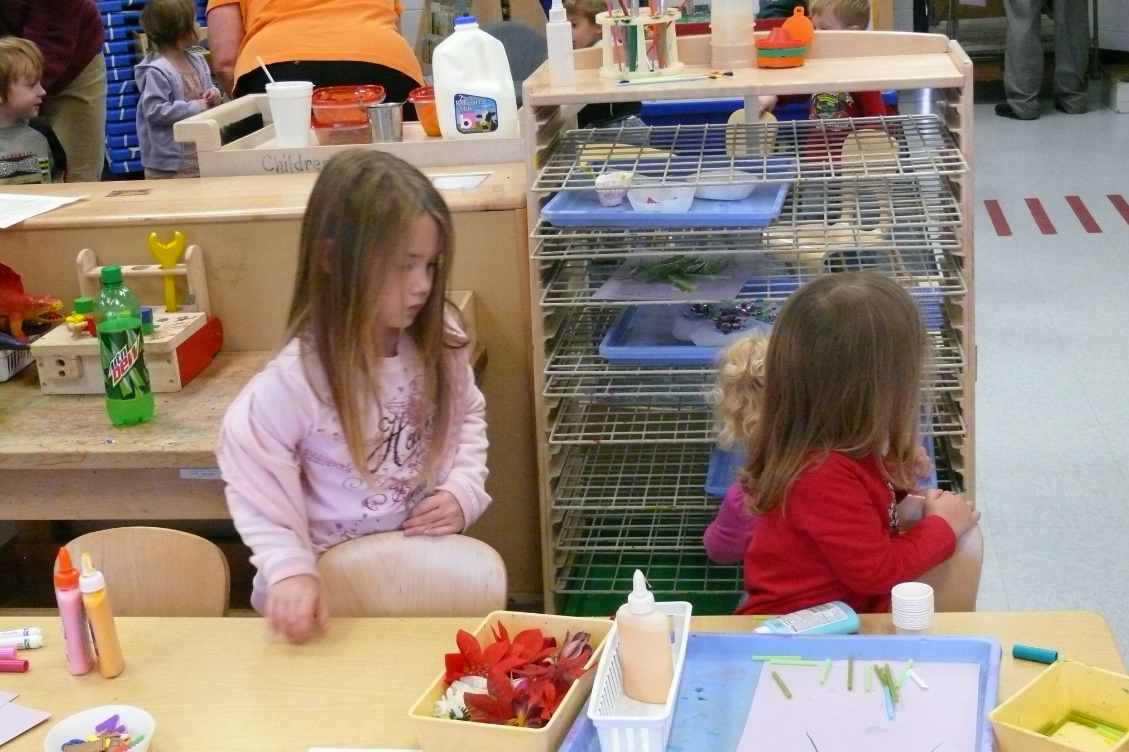
  Centers will be well-equipped for learning and play.

Slide 38
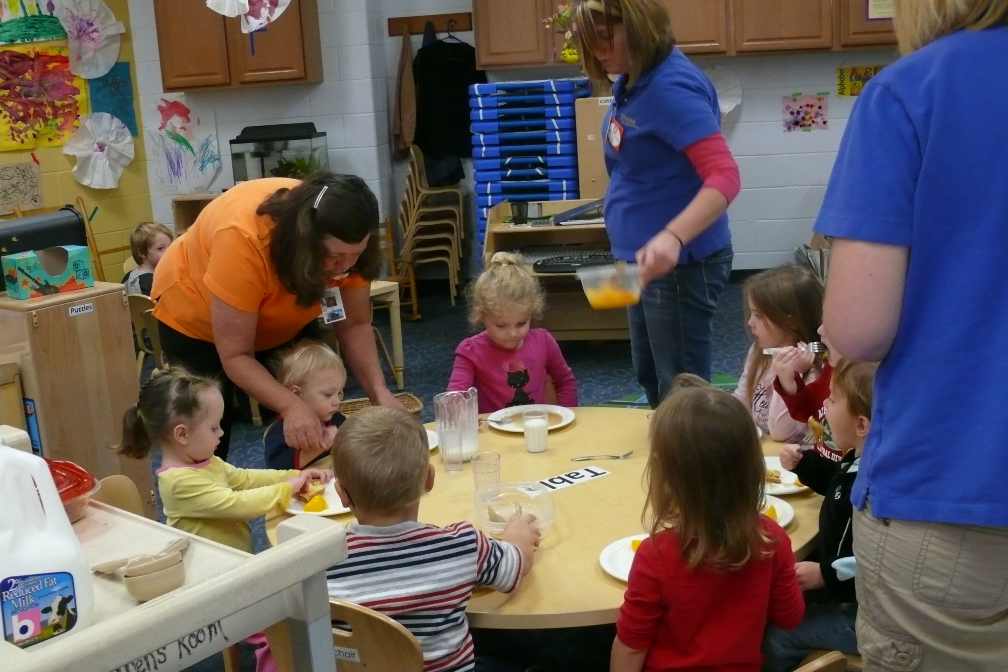
  Teacher/child ratios will be small.

Slide 39
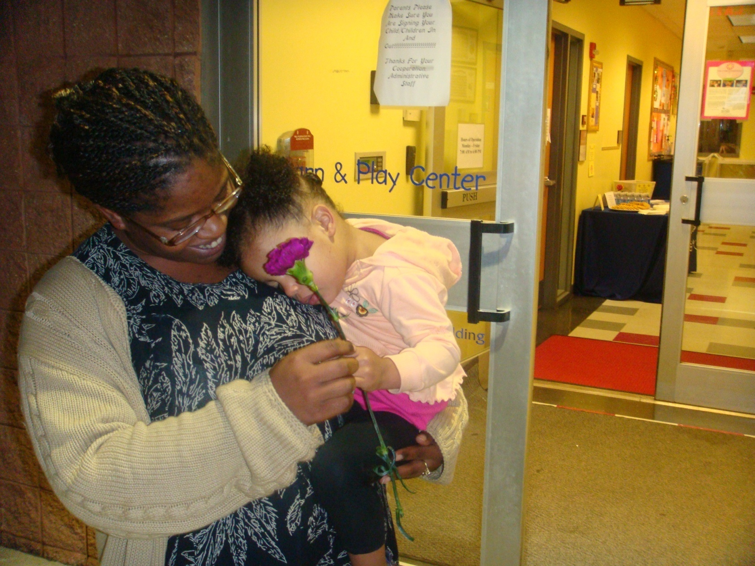
  Parents will be more involved and educated about
  their role in their child’s development.

Slide 40
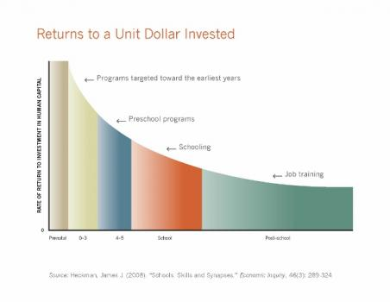
  Communities will get the highest possible
  return on their investment.

Slide 41
  More WV children will finish third grade “reading to learn.”

Slide 42
You can help make West Virginia a great place to be a kid by advocating for the funding to implement a Childcare Quality Rating and Improvement System.

Slide 43
Want to learn more about KIDS COUNT and explore our data?

Slide 44

Visit our website.
www.wvkidscount.org

Slide 45
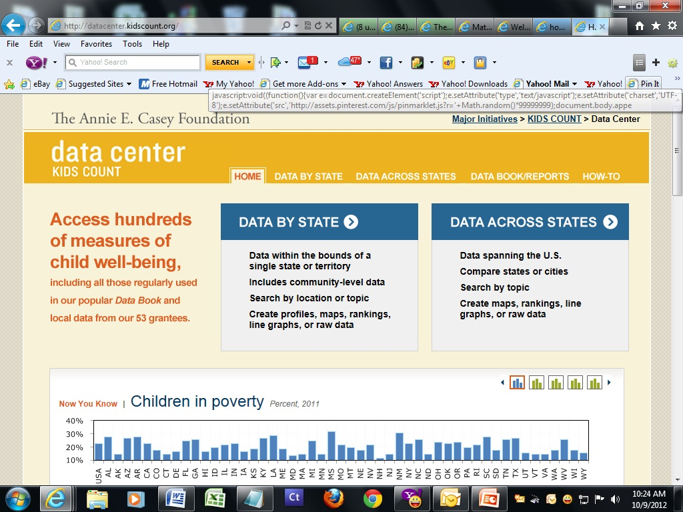
Explore the National
KIDS COUNT Data Center.
http://datacenter.kidscount.org

Slide 46
Questions?
Margie Hale, Executive Director
West Virginia KIDS COUNT
1206 Virginia St., E. Suite 104
Charleston, WV 25301
304-345-2101 or 1-888-KIDSCOUNT margie@wvkidscount.org www.wvkidscount.org

